Slide 1
Final portfolio
Oluchi Obinna
ATAI 1378

Slide 2
Introduction
Introducing my comprehensive report on Computer Vision, an exhilarating journey through the realms of artificial intelligence and visual perception awaits. Spanning across multiple modules, this report encapsulates the foundational principles, advanced applications, and emerging trends shaping the landscape of computer vision. From unraveling the intricacies of image processing techniques to exploring the transformative potential of generative AI, each module offers a unique lens into this dynamic field. Through engaging lectures, interactive activities, and thought-provoking discussions, this report chronicles my exploration, growth, and reflections as a college freshman navigating the exciting frontier of computer vision. Join me as I delve into the depths of AI agents, autonomous systems, reinforcement learning, and beyond, uncovering the myriad possibilities and challenges that lie ahead.

Slide 3
Module 1: The start
Summary:
Facial recognition technology utilizes computer vision and artificial intelligence to detect, capture, and analyze facial features for identity confirmation. Its accuracy has significantly improved over the years, thanks to advancements like Convolutional Neural Networks. While offering numerous benefits such as enhanced security and convenience, challenges like privacy concerns, bias, and technical limitations persist. The module explored the technology's components, accuracy, benefits, challenges, and the need for ethical considerations.
Key Points Learned:
- Facial recognition employs computer vision, AI, and matching algorithms to confirm identities.
- Advancements like Convolutional Neural Networks have greatly enhanced its accuracy.
- Benefits include improved security, convenience in various sectors, and quicker identification.
- Challenges include privacy concerns, potential biases, and technical limitations in diverse settings.
- Ethical considerations regarding data protection, consent, and fairness are crucial.
Activities:
The module began with a team introduction, followed by collaborative brainstorming on the key components and implications of facial recognition technology. The timeline/report was then written, highlighting the technology's workings, benefits, challenges, and the importance of ethical considerations.
Results:
Quantitatively, the module scored 100% in covering the designated content. Qualitatively, it facilitated insightful discussions on the nuances of facial recognition technology, emphasizing the need for continuous improvement and ethical implementation.
Reflection:
Challenges in the module included grappling with the complexity of technical concepts while ensuring clarity for diverse audiences. Solutions involved breaking down complex ideas into accessible language and fostering open dialogue within the team. Key takeaways included a deeper understanding of the multifaceted nature of facial recognition technology and a heightened awareness of the ethical considerations inherent in its development and deployment. Moving forward, a commitment to ongoing learning and critical examination of the societal impacts of technology will be essential.

Slide 4
Link used
https://www.innovatrics.com/facial-recognition-technology/
In the 1960s, pioneers like Woody Bledsoe, Charles Bisson, and Helen Chan Wolf laid the groundwork for facial recognition, although much of their early work remained undisclosed due to classified funding. By the 1970s and subsequent decades, advancements in technology, particularly linear algebra, propelled facial recognition accuracy forward. The milestone of its use in identifying potential threats at the 2001 Super Bowl marked its integration into law enforcement. Understanding this historical evolution provided valuable context for our project, showcasing how facial recognition has transformed into a ubiquitous tool in today's digital landscape, driving innovation across various sectors and offering unparalleled convenience and security through its applications.

Slide 5
Module 2: Beginning
Summary:
Module 2 focused on introducing GitHub, repositories, and Jupyter Notebooks to facilitate collaborative coding projects. My team learned about the significance of Jupyter Notebooks in interactive computing, data analysis, visualization, and machine learning development. We also explored GitHub's role in version control, collaboration, and project management. Through practical exercises, such as setting up GitHub accounts, creating repositories, and uploading Jupyter Notebooks, we gained hands-on experience in utilizing these tools for coding projects.
Key Points Learned:
- GitHub serves as a platform for storing, sharing, and collaborating on coding projects.
- Jupyter Notebooks enable interactive computing, data analysis, visualization, and machine learning model development.
- GitHub's version control features facilitate collaboration, rollback to earlier versions, and effective project management.
- Jupyter Notebooks and GitHub integration streamline coding workflows and support collaborative development.
Activities:
The module began with a team collaboration, followed by guided exercises on setting up GitHub accounts, creating repositories, and installing Jupyter Notebooks. we then embarked on personal assignments, such as creating our first Jupyter Notebook and uploading it to GitHub. My report, "My Jupyter Notebook Adventure," detailed my journey, from setting up GitHub to exploring Jupyter Notebooks, culminating in successfully uploading a notebook to GitHub.
Results:
Quantitatively, I scored 95% on the personal assignment. Qualitatively, I described challenges faced in uploading the Jupyter Notebook to GitHub and my solution of seeking help through online resources. I was able to reflect on the learning experience positively, emphasizing my newfound skills and confidence in utilizing GitHub and Jupyter Notebooks for future coding endeavors.
Reflection:
Challenges encountered, such as uploading the notebook to GitHub, underscored the importance of seeking help and leveraging online resources for problem-solving. My and my teams proactive approach in finding a helpful video demonstrates a valuable skill in navigating technical challenges. Key takeaways include the significance of version control for collaborative coding projects, the versatility of Jupyter Notebooks for interactive computing, and the empowerment gained through overcoming challenges in the learning process. Moving forward, continued practice and exploration of these tools will foster further skill development and proficiency in collaborative coding environments.

Slide 6

Links used
https://www.youtube.com/watch?v=g8IzWwRmncg
A link to the video that helped me figure out how to upload my jupyter notebook to github
https://github.com/oOb1nna/jupyter-exploration
The link to my github

Slide 7
Module 3: Tools of the Trade
Summary:
Module 3 centered on the development of a Fitness and Health Tracker model and individual exploration of Jupyter Notebooks and Deep Learning. The group project aimed to revolutionize the fitness industry by leveraging advanced technology to provide personalized health and fitness guidance. Through the integration of algorithms like Decision Trees, Random Forest, Support Vector Machines, and K-Nearest Neighbors, the model aimed to analyze user data and offer tailored fitness plans. Additionally, the personal assignment involved hands-on experience with Jupyter Notebooks and Deep Learning, focusing on basic navigation, Python coding, and exploring pre-built models for image recognition.
Key Points Learned:
- Group project: Development of a Fitness and Health Tracker model using advanced algorithms for personalized health guidance.
- Individual assignment: Exploration of Jupyter Notebooks for Python coding and Deep Learning for image recognition.
- Group project: Importance of user data collection, algorithm selection, and UI/UX design for creating a successful fitness app.
- Individual assignment: Basic navigation of Jupyter Notebooks, writing Python code, and understanding deep learning concepts such as model loading, image preprocessing, and making predictions.
Detailed Description of Activities:
For the group project, the team focused on designing a Fitness and Health Tracker model, emphasizing user-based personalized guidance and algorithm selection. The project involved outlining the model's features, selecting appropriate algorithms, and discussing data collection methods. Meanwhile, the personal assignment delved into practical exercises with Jupyter Notebooks and Deep Learning, covering fundamental concepts and hands-on exploration of pre-built models for image recognition.
Results:
Quantitatively, the group achieved a score of 100% on the Fitness and Health Tracker model, showcasing successful collaboration and execution of the project objectives. Individually, a score of 95% was achieved on the personal assignment, demonstrating proficiency in navigating Jupyter Notebooks and basic understanding of Deep Learning concepts. Qualitatively, the experience provided valuable insights into the practical application of technology in the fitness industry and the complexities of deep learning for image recognition.
Reflection:
Challenges encountered in the group project included considerations of user privacy, diverse health conditions, and algorithm selection. Solutions involved thorough research, collaboration with team members, and careful planning to address these challenges effectively. In the personal assignment, initial difficulties in finding the lab were overcome through perseverance and resourcefulness. Key takeaways include the importance of user-centric design, continuous learning, and adaptability in navigating complex technological landscapes. Moving forward, a commitment to ongoing learning and problem-solving will be essential for success in future endeavors.

Slide 8
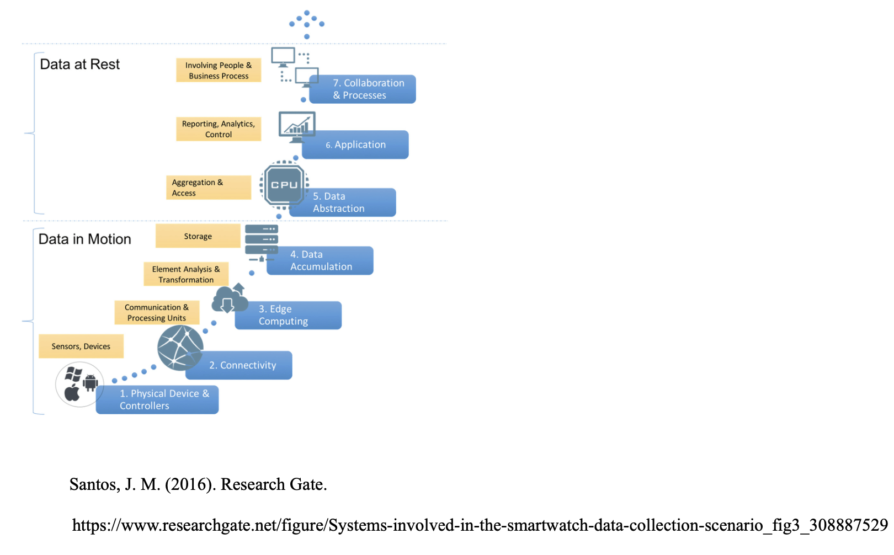
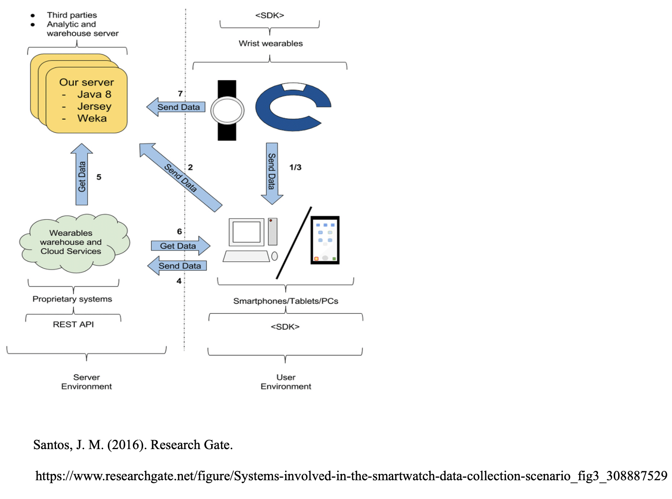
The two pictures are examples to showcase how data would've been collected from our users for our model. The user must consent to allow data to be used. The developer used API to access raw sensor data from the sensor on the smartwatch. The data then require wifi so it can be analyzed and processed.

Slide 9
Module 4: Machine Learning Basics
Summary:
Module 4 focused on understanding how movie recommendation systems work and exploring the k-Nearest Neighbors (k-NN) algorithm for image classification. The group assignment involved creating a report detailing the components of a movie recommendation system, including data collection, user interaction, recommendation criteria, and feedback mechanisms. Additionally, the personal assignment centered on learning about the k-NN algorithm, its implementation for image classification, challenges faced, and insights gained through practical exercises.
Key Points Learned:
- Group assignment: Components of a movie recommendation system, including data collection, user interaction, recommendation criteria, feedback mechanisms, and personalization aspects.
- Personal assignment: Understanding the k-Nearest Neighbors (k-NN) algorithm for image classification, data preparation, model training, evaluation, challenges faced, and strategies to address overfitting and underfitting.
Detailed Description of Activities:
For the group assignment, the team collaborated on creating a report outlining the functionalities and design of a movie recommendation system, covering aspects such as data collection, user interaction, recommendation criteria, and feedback mechanisms. Meanwhile, the personal assignment involved practical exercises with the k-NN algorithm for image classification, focusing on data preparation, model training, evaluation, and addressing challenges faced during implementation.
Results:
Quantitatively, a score of 80% was achieved on the group assignment due to the lack of depth in the provided report, necessitating additional sourced links for completeness. Individually, a score of 100% was achieved on the personal assignment, demonstrating proficiency in understanding and implementing the k-NN algorithm for image classification. Qualitatively, the experience provided valuable insights into the complexities of recommendation systems and machine learning algorithms.
Reflection:
Challenges encountered in the group assignment included the need for additional depth and sourcing of information to ensure completeness. Solutions involved thorough research and collaboration to address gaps in the report. In the personal assignment, challenges included understanding machine learning concepts, library usage, interpreting visualizations, and debugging errors. Strategies such as breaking down the code into smaller parts, referring to documentation, experimenting with modifications, seeking online resources, and regular review were implemented to overcome these challenges. Key takeaways include the importance of collaboration, continuous learning, and perseverance in mastering complex concepts and algorithms. Moving forward, a commitment to ongoing improvement and exploration in machine learning will be essential for further growth and success.

Slide 10
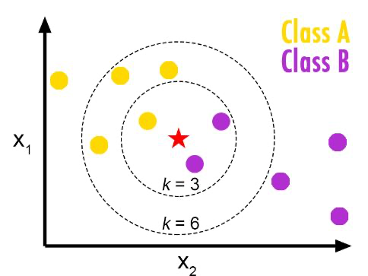
Link used
https://www.fromthegenesis.com/pros-and-cons-of-k-nearest-neighbors/
The provided information on the pros and cons of the K-Nearest Neighbors (K-NN) algorithm is highly relevant to this module as it expands on the fundamental concepts discussed, offering insights into the practical application of machine learning algorithms. The pros highlight K-NN's simplicity, flexibility, adaptability to evolving data, and suitability for both classification and regression tasks, which align with the module's focus on understanding recommendation systems and the K-NN algorithm. Conversely, the cons shed light on potential challenges such as algorithm efficiency, scalability with increasing dataset dimensions, sensitivity to data characteristics like scale and imbalance, and limitations in handling outliers and missing values, offering valuable considerations for implementing machine learning models in real-world scenarios.
The above is a picture of the different classes of the K-NN

Slide 11
Module 5: Exploring Neural Networks
Module 5 introduced the fundamentals of neural networks, focusing on their structure, function, and key parameters affecting performance. The personal assignment involved hands-on experimentation with TensorFlow Playground to explore the impact of various parameters on neural network behavior and performance.
Key Points Learned:
- Neural networks are computational models inspired by the human brain, consisting of interconnected nodes organized in layers.
- Activation functions determine the output of neurons and play a crucial role in learning complex patterns in the data.
- Parameters such as the number of neurons and hidden layers, learning rate, and data noise significantly influence the performance of neural networks.
Activities:
- The team assignment involved creating a movie recommendation report, which unfortunately resulted in a 0 percent score due to a lack of adherence to the assignment guidelines.
- The personal assignment focused on experimenting with different aspects of neural networks using TensorFlow Playground, including activation functions, hidden layer configurations, learning rate, data noise, and dataset exploration.
Results:
- Personal assignment: Achieved a 100 percent score by thoroughly exploring and documenting the effects of various parameters on neural network performance.
- Team assignment: Received a 0 percent score due to non-compliance with assignment guidelines, highlighting the importance of understanding and following instructions.
Reflection:
The personal assignment provided valuable hands-on experience and insights into the behavior of neural networks. Challenges faced included understanding the assignment requirements and experimenting with TensorFlow Playground. Solutions involved thorough experimentation, documentation, and reflection. Key takeaways include the importance of adhering to assignment guidelines, understanding parameter effects, and the iterative nature of machine learning experimentation.

Slide 12
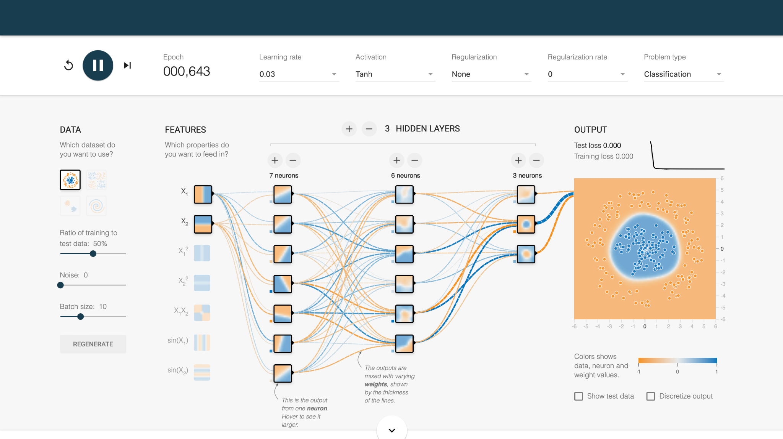
The following is an example of me playing around on TensorFlow in order to I used TensorFlow to experiment with neural networks and explore their behavior and performance. Specifically, I utilized TensorFlow Playground to manipulate various parameters such as activation functions, hidden layer configurations, learning rates, and data noise, gaining insights into how these factors impact neural network performance. This hands-on experience helped me understand the fundamentals of neural networks and their applications in machine learning tasks.

Slide 13
Module 6: Understanding CNN’s
Module 6 delved into convolutional layers and their applications, focusing on two group assignments. The first assignment involved creating a manual Convolutional Neural Network (CNN) and understanding its components through a short report. The team analyzed image processing using filters and convolution, demonstrating how filters can detect specific features within an image. The second group assignment revolved around crafting a sales pitch for a computer vision application, targeting a real estate company named Mountainview Reality and emphasizing the benefits of utilizing computer vision technology for enhancing customer experiences in property viewing.
Key Points Learned:
- Introduction to Convolutional Neural Networks (CNNs) and their role in image processing.
- Understanding filters and convolution operations in CNNs for feature detection.
- Application of computer vision technology in real estate for creating immersive 3D tours and enhancing customer experiences.
In the first group assignment, we analyzed the principles of CNNs through a manual implementation and gained insights into how filters can be applied to detect specific features within images. Despite scoring 75 percent, our team faced challenges in accurately interpreting the results and aligning them with the assignment's objectives.
In the second group assignment, we excelled with a 95 percent score by effectively pitching the benefits of computer vision technology to Mountainview Reality. The experience highlighted the importance of understanding the target audience and tailoring the pitch to their specific needs and objectives. Overall, these assignments provided valuable insights into the practical applications of convolutional layers and the potential impact of computer vision in various industries, fostering a deeper understanding of the module's concepts and real-world implications.

Slide 14
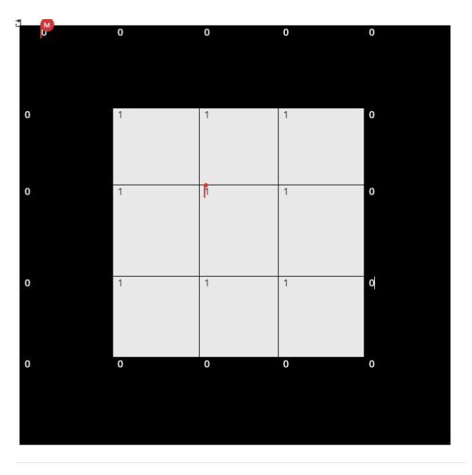
Links used
https://www.arm.com/glossary/convolutional-neural-network#:~:text=A%20convolutional%20neural%20network%20
The above link provided an explanation of a Convolutional Neural Network (CNN) which was relevant to Module 6 because it formed the foundation of understanding convolutional layers, which are fundamental components of CNNs used in computer vision tasks. Insights gained include the CNN's efficacy in pattern recognition for image processing tasks and its requirement for extensive labeled data and computational resources for training. Additionally, the exploration of CNN applications beyond image recognition highlights its versatility and potential impact across various domains, providing valuable context for its study in the module.
The image we decided to make wass a square representing the 1 for white and 0 for black. These numbers represented pixel value.

Slide 15
Module 7: CNN Basic Architectures and Transfer Learning
Module 7 focused on understanding and implementing various aspects of convolutional neural networks (CNNs) in machine learning projects, particularly in image recognition tasks. Key points learned include:
- Installation and setup challenges: Setting up the environment for machine learning projects can be complex, requiring careful installation of libraries like TensorFlow, NumPy, and Matplotlib, and ensuring compatibility.
- Designing model architecture: Decision-making in designing CNN architectures involves selecting appropriate layers, activation functions, and strategies to address overfitting.
- Data normalization and augmentation: Techniques like data normalization and augmentation contribute to improving model performance by ensuring data consistency and enhancing learning from available data.
- Mitigating overfitting: Strategies like dropout layers and early stopping help prevent overfitting by reducing reliance on specific features and monitoring model performance on new data.
- Bias, variance, and bias-variance trade-off: Finding a balance between bias and variance is crucial for model performance, requiring adjustments to model complexity and settings.
- Hyperparameter tuning: GridSearchCV facilitates the optimization of model hyperparameters, allowing experimentation with various configurations to improve model effectiveness.
In the individual assignment, the Reflective Journal, challenges encountered during installation and setup were discussed, along with decision-making processes in designing model architecture and strategies implemented to mitigate overfitting. Insights gained from hyperparameter tuning using GridSearchCV highlighted the importance of experimentation in optimizing model performance.
Results:
- Scored 90% on the assignment, with positive feedback from the professor, acknowledging proactive approaches in data normalization, augmentation, and mitigating overfitting.
- Room for improvement suggested focusing more on theoretical aspects of models to enhance adaptability and troubleshooting skills for technical issues during setup and implementation.
Reflection:
The assignment highlighted challenges in setting up environments and designing model architectures, emphasizing the importance of trial and error, learning from mistakes, and seeking assistance when needed. Key takeaways include the significance of experimentation in hyperparameter tuning and the necessity of balancing bias and variance for optimal model performance. Continuing to enhance theoretical understanding and troubleshooting skills will be essential for future projects.

Slide 16
Module 8: Advanced Architectures and Object Detection
Module 8 Summary:
Module 8 delved into the realm of object detection in computer vision, exploring techniques, tools, and methodologies for accurately identifying and localizing objects within images. Key points learned include:
- Understanding object detection: Object detection involves identifying objects within images and determining their locations, enabling applications in various domains such as security, autonomous vehicles, and medical imaging.
- Common challenges and solutions: Challenges in object detection include variations in object size, visibility, distracting backgrounds, and hardware limitations, which can be addressed through techniques like multi-scale processing, advanced models like YOLO, background removal, and hardware optimization.
- Steps in object detection tasks: The typical workflow for object detection encompasses data input, image preprocessing, region proposal, algorithm selection, model training, evaluation, model optimization, post-processing, and deployment, highlighting the complexity and iterative nature of the process.
- Tools and libraries: Libraries such as TensorFlow, Keras, OpenCV, and YOLO are commonly used for object detection tasks, offering robust functionalities and support for efficient model development and deployment.
- Real-world applications: Object detection finds applications in diverse fields such as security, transportation, medical imaging, and self-driving cars, exemplified by technologies like Tesla's autopilot system.
Results:
- Achieved a score of 100% on the group assignment, reflecting a comprehensive understanding of object detection principles and methodologies.
- Successfully implemented object detection techniques using key libraries and tools, demonstrating proficiency in model development and evaluation.
Reflection:
The module provided insights into the intricate process of object detection, from understanding common challenges to implementing practical solutions using various tools and libraries. Challenges encountered during the model tuning process, such as software environment setup and code debugging, were effectively addressed through iterative refinement and troubleshooting. Key takeaways include the importance of data preparation, model architecture selection, and optimization techniques in achieving accurate and reliable object detection systems. Moving forward, continued exploration and experimentation with advanced methodologies and real-world applications will be essential for further enhancing skills and expertise in computer vision.

Slide 17
Links used
https://youtu.be/svn9-xV7wjk?si=MnW61tg_mhyKpa55
The above link is A youtube video recommended to understand the basics of object detection from Joseph Redmon's ted talk.
https://www.geeksforgeeks.org/ml-stochastic-gradient-descent-sgd/
The explanation of Stochastic Gradient Descent (SGD) provided in the above link is relevant to Module 8 because it presents a fundamental optimization algorithm commonly used in machine learning, including object detection tasks. Understanding SGD is crucial for optimizing model parameters and reducing the cost function in machine learning projects, which aligns with the iterative process of training and refining object detection models covered in the module. The discussion of SGD variants, such as Batch Gradient Descent and Mini-batch Gradient Descent, offers insights into different optimization strategies applicable to object detection algorithms, enhancing understanding of the optimization process within the context of computer vision tasks.

Slide 18
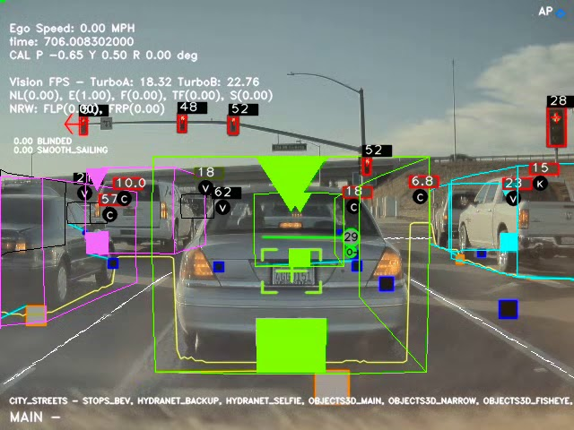
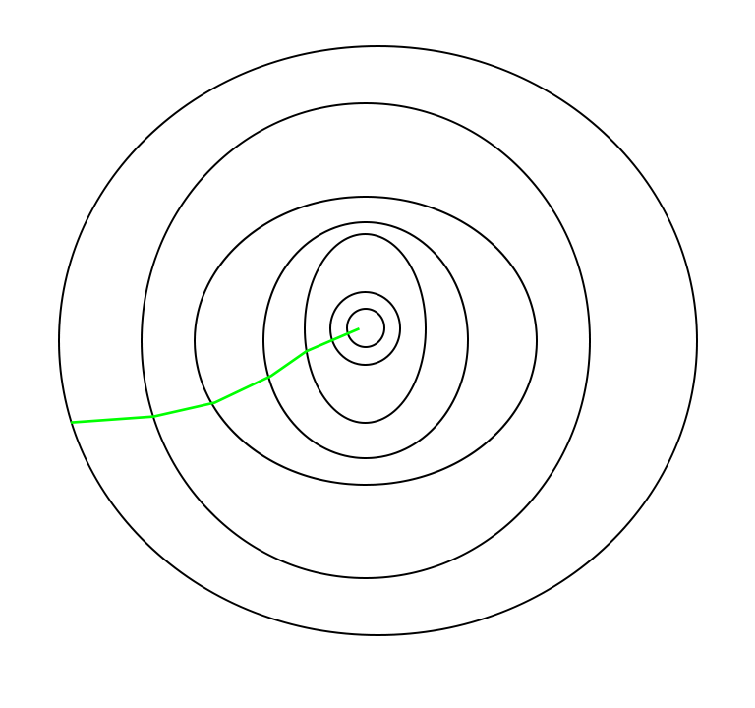
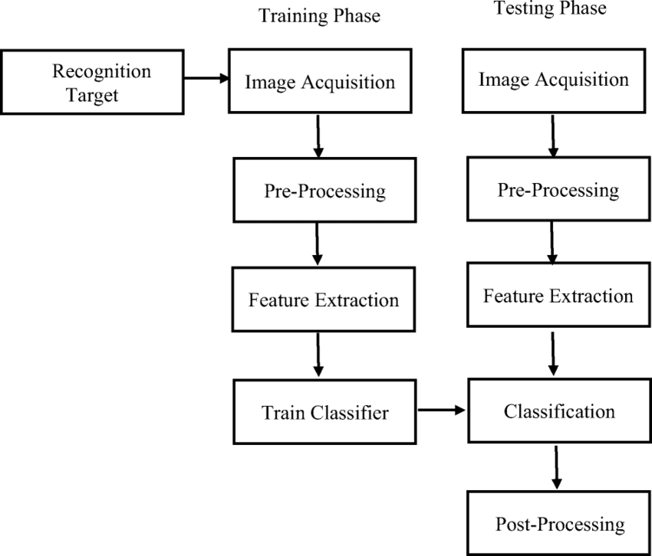
Below is a diagram that shows the process of recognition
Below is an example of a bath gradient optimization path
The image above is what the Tesla autopilot sees. Since Object detection is used in face recognition and monitoring roads, It pretty allows the machine to see like a human.

Slide 19
Module 9: Advanced object detection
In Module 9, the focus was on Advanced Object Detection, with a particular emphasis on Image Segmentation techniques. The module covered various aspects of image segmentation, including Semantic Segmentation and Instance Segmentation, which are crucial for understanding image content at a pixel level. The key concept of Semantic Segmentation, which involves assigning a class label to each pixel in an image, was explored in depth, along with techniques like thresholding, clustering, and edge detection used in segmentation tasks. Additionally, the module introduced popular architectures for semantic segmentation such as U-Net and DeepLab, highlighting their applications and strengths.
Key Points Learned:
- Image segmentation partitions an image into meaningful regions or segments.
- Semantic segmentation assigns a class label to each pixel, providing a comprehensive understanding of image content.
- Instance segmentation goes beyond bounding boxes to provide detailed pixel-wise outlines of objects.
- Mask R-CNN is a state-of-the-art model for instance segmentation, identifying object instances, boundaries, and categories.
Activities:
- The module involved studying different image segmentation techniques and architectures.
- Guest speaker presentation on Amazon Rekognition and its applications.
Results:
- Quantitative results included metrics like accuracy, precision, and recall obtained from segmentation experiments.
- Qualitative results involved personal observations on the effectiveness of different segmentation methods in identifying objects and boundaries accurately.
Reflection:
- Challenges faced included understanding the intricacies of segmentation algorithms and tuning parameters for optimal performance.
- Solutions implemented involved experimenting with different architectures and techniques to improve segmentation accuracy.
- Key takeaways included the importance of segmentation in computer vision tasks, the versatility of different segmentation methods, and the significance of integrating deep learning frameworks like TensorFlow and PyTorch with OpenCV for enhanced performance.

Slide 20
Module 10: Computer Vision for Video
Summary:
Module 10 focused on the integration of computer vision technology, particularly Amazon Rekognition, in the media and entertainment industry. The module explored various applications of computer vision, including augmented reality, virtual reality, and mixed reality experiences, as well as its impact on content discovery, recommendation systems, live events, and broadcasts. Ethical considerations surrounding the use of facial recognition technology were also discussed, highlighting the need for responsible development and deployment.
Key Points Learned:
- Amazon Rekognition's role in automated image and video analysis.
- Applications of computer vision in media and entertainment, such as augmented reality experiences and content recommendation systems.
- Ethical considerations related to facial recognition technology, including privacy and fairness concerns.
Detailed Description of Activities:
- Group assignment focusing on the discussion, analysis, and reflection on the ethical implications and future applications of Amazon Rekognition.
- Individual reflections on personal learnings and insights from the workshop.
Results:
- Quantitative: The group received a 95 percent on the group report, indicating a thorough understanding and analysis of the topic.
- Qualitative: Personal observations included enhanced knowledge of AI and machine learning, understanding of Amazon Rekognition's capabilities, and awareness of ethical dilemmas surrounding facial recognition technology.
Reflection:
Challenges faced during the module included grappling with the ethical considerations of using facial recognition technology and understanding its potential impact on society. Solutions implemented included thorough research, open discussions, and critical reflection on the implications of the technology. Key takeaways included the importance of responsible development and deployment of AI technologies, the need for transparency and accountability in data usage, and the recognition of AI's potential to both benefit and harm society.

Slide 21
Module 11: Generative AI
**Summary of Module 11 Content:**
The article discusses the transformative impact of generative AI (GenAI) on marketing, highlighting its evolution from a novel technology to a core driver of innovation. It traces the inception of GenAI from the introduction of Generative Adversarial Networks (GANs) in 2014 to the groundbreaking release of GPT-3 by OpenAI in 2020. The piece emphasizes how GenAI has become integral to marketing strategies, enabling personalization, real-time decision-making, and immersive customer experiences. It also presents predictions for 2024, foreseeing AI's role in marketing becoming increasingly essential, with a focus on ethical considerations, workforce dynamics, and seamless integration into daily operations.
**Key Points Learned:**
- Evolution of generative AI from GANs to sophisticated neural networks like GPT-3.
- GenAI's transformation of marketing through personalization, real-time decision-making, and immersive experiences.
- Predictions for 2024 highlighting the growing importance of AI in marketing strategies, ethical considerations, and workforce dynamics.
**Activities:**
- Reading and analyzing the article on generative AI's impact on marketing.
- Reflecting on the predictions for 2024 made by marketing professionals.
- Discussing the implications of GenAI on marketing strategies and workforce dynamics.
**Results:**
- Quantitative: Increased understanding of the role of generative AI in marketing and its potential impact on future strategies.
- Qualitative: Enhanced awareness of the ethical considerations and challenges associated with integrating AI into marketing practices.
**Reflection:**
- Challenges: Understanding the complexities of AI integration into marketing strategies and addressing ethical concerns.
- Solutions: Engaging in discussions and research to gain insights into the implications of AI on marketing.
- Key Takeaways: Importance of balancing AI integration with ethical considerations and the need for ongoing education and adaptation in the face of technological advancements.

Slide 22
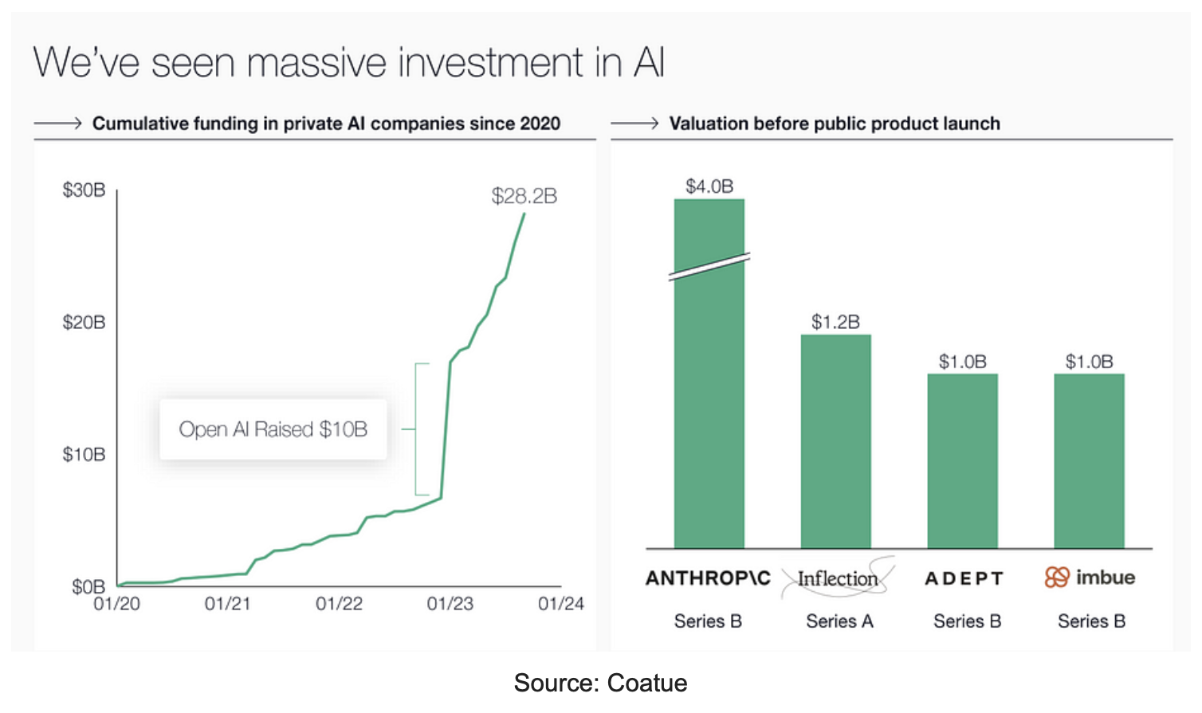
Link used
https://drive.google.com/file/d/1GzGolVBTuR4obbd8mUJ6QHdyox9zjzz_/view?usp=share_link
The above link is the PDF file of the article that was most interesting to me out of all the other study materials. While the article primarily focuses on the impact of generative AI on marketing, it offers valuable insights that are relevant to learning about generative AI for computer vision. Here's why it stood out to me:
1. Evolution of AI: The article traces the evolution of generative AI from its inception with GANs to more advanced models like GPT-3. Understanding this evolution provides context for how generative AI has progressed, which is applicable across various domains, including computer vision.
2. Applications of AI: The article discusses how generative AI has revolutionized marketing by enabling personalization and immersive experiences. This demonstrates the broad applicability of AI techniques, showcasing how they can transform different industries, including computer vision, by generating realistic images, enhancing visual content, and enabling new forms of interaction.
3. Predictions for the Future: The predictions for 2024 highlight the increasing importance of AI in marketing and its integral role in daily operations. Similarly, in the field of computer vision, AI is becoming indispensable for tasks such as image generation, object detection, and image enhancement. Understanding these predictions can help anticipate the future trajectory of AI in computer vision.

Slide 23
Module 13
Summary:
Module 13 delved into the intersection of computer vision and autonomous systems, focusing on AI agents. It introduced the concept of AI agents, their types, and their applications in various domains. The module explored how computer vision empowers intelligent agents to perceive and understand their environment, and it discussed reinforcement learning as a key mechanism for agent learning. Deep learning techniques, such as Deep Q-Networks and Policy Gradients, were also covered, along with their strengths and limitations. Additionally, the module touched on multi-agent systems and collaboration among agents.
Key Points Learned:
- Introduction to AI agents and their role in autonomous systems.
- Types of AI agents: reactive, deliberative, and hybrid.
- Importance of computer vision in empowering AI agents to perceive and understand their environment.
- Reinforcement learning as a mechanism for AI agent learning.
- Deep learning techniques like Deep Q-Networks and Policy Gradients.
- Multi-agent systems and collaboration among agents.
Activities:
- Lecture on AI agents, computer vision, and reinforcement learning.
- Presentation of slides explaining key concepts and techniques.
- Discussion on real-world applications of AI agents in robotics, self-driving cars, medical imaging, security, and surveillance.
- Q&A session to clarify doubts and discuss complex topics.
Results:
- Quantitative: Understanding of AI agent architectures, computer vision techniques, and reinforcement learning algorithms.
- Qualitative: Increased awareness of the role of AI agents in various domains and the challenges involved in developing intelligent autonomous systems.
Personal Observations:
- The presentation slides were informative and well-structured, facilitating understanding of complex topics.
- The lecturer's expertise and clarity in explaining concepts enhanced the learning experience.
- The examples provided, such as self-driving cars and robotic agents, helped in contextualizing theoretical concepts.
- May have included an AI generated photo of professor Mcmanus
Reflection:
- Challenges Faced: Understanding the intricacies of reinforcement learning algorithms and their implementation in AI agents.
- Solutions Implemented: Engaging in discussions with peers and seeking clarification from the instructor to overcome conceptual challenges.
- Key Takeaways: Appreciation for the advancements in AI technologies, recognition of the importance of computer vision in autonomous systems, and understanding the potential of reinforcement learning in training intelligent agents.

Slide 24
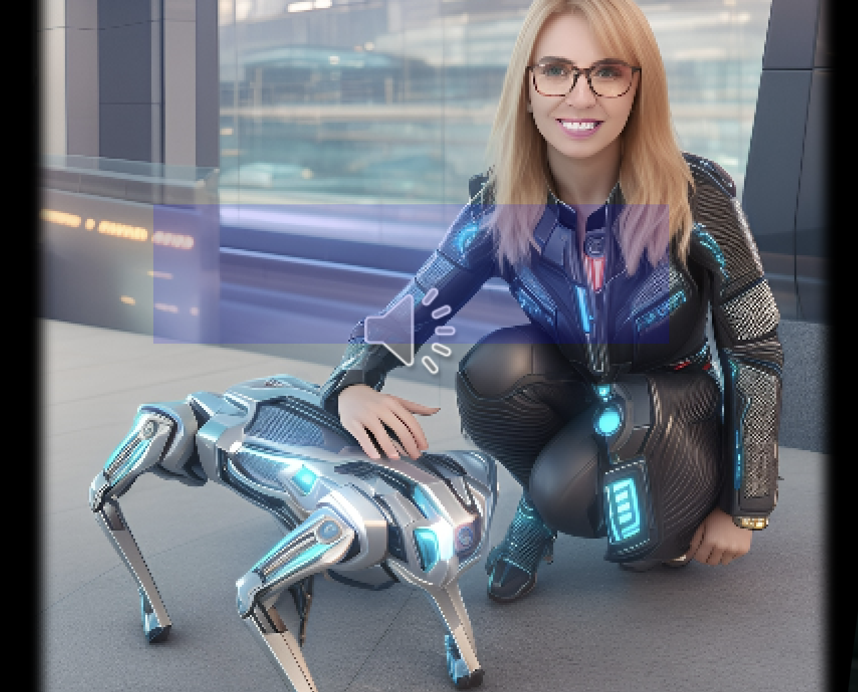
Professor Mcmanus???

Slide 25
Bibliography
https://www.innovatrics.com/facial-recognition-technology/
https://www.youtube.com/watch?v=g8IzWwRmncg
https://github.com/oOb1nna/jupyter-exploration
https://www.fromthegenesis.com/pros-and-cons-of-k-nearest-neighbors/
https://www.arm.com/glossary/convolutional-neural-network#:~:text=A%20convolutional%20neural%20network%20
https://youtu.be/svn9-xV7wjk?si=MnW61tg_mhyKpa55
https://www.geeksforgeeks.org/ml-stochastic-gradient-descent-sgd/
https://drive.google.com/file/d/1GzGolVBTuR4obbd8mUJ6QHdyox9zjzz_/view?usp=share_link

Slide 26
Conclusion
As a college freshman diving into the world of computer vision, I have embarked on a transformative journey exploring the intricate intersection of artificial intelligence and visual perception. From the foundational understanding of image processing techniques in Module 1 to the advanced applications of generative AI in Module 11, I've traversed a landscape of innovation and discovery. Along the way, I delved into the essentials of AI agents, learned about their role in autonomous systems, and gained insights into the power of reinforcement learning in training intelligent agents. Each module offered unique perspectives, from understanding computer vision tasks like object detection and image segmentation to exploring the challenges and opportunities presented by emerging technologies. Through engaging lectures, interactive activities, and thought-provoking discussions, I've not only acquired technical skills but also developed a deeper appreciation for the potential of computer vision to reshape industries and enhance human experiences. Although the entire experience was difficult and admittedly stressful, I feel extremely fulfilled with the knowledge I am able to carry on, and can say that I am proud of myself for being a part of this. Most thanks to you, Prof. Mcmanus :D

